Slide 1
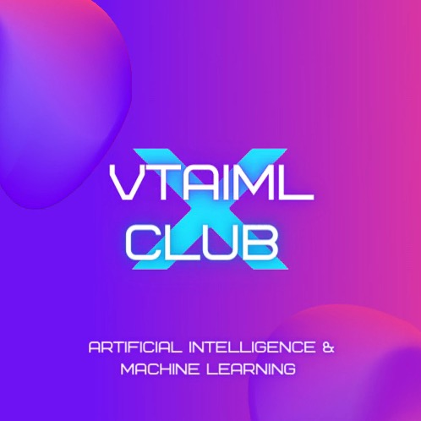
Transformers
April 26th, 2023

Slide 2
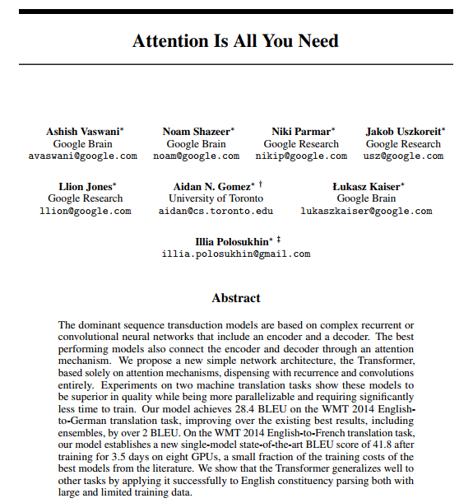
Introduction
Neural network architecture developed to solve sequence transduction
Game changer for NLP: effectively gain very long-term memory.
No recurrent units - only attention
Paper: “Attention is All You Need” (2017)

Slide 3

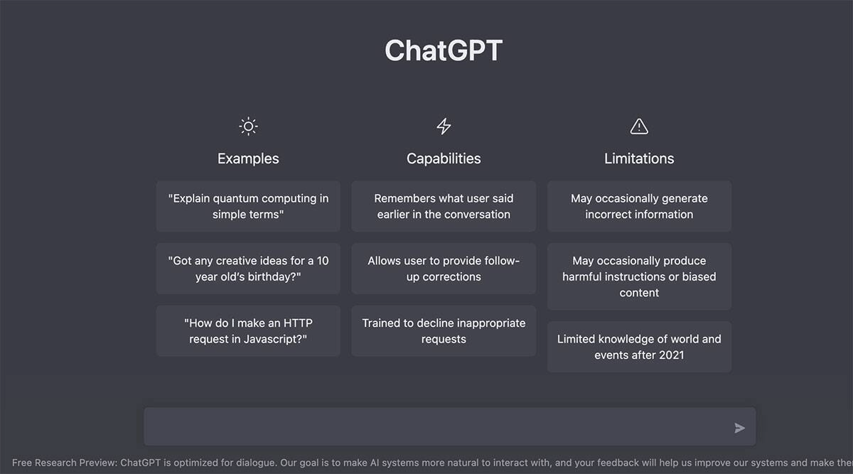
Applications
BERT: language representation model
OpenAI Codex, Github CoPilot: code generation
GPT (Generative Pre-Trained Transformer)
  ChatGPT: conversational Q&A bot, built on GPT-3.5/4

Slide 4
Model Architecture

Slide 5
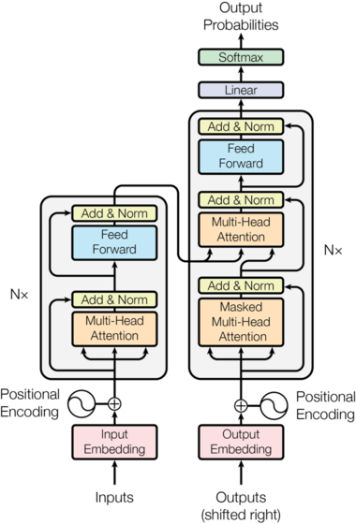

Slide 6
Overview
Encoder-decoder architecture
Encoder: input = input sequence, updates it
Decoder: input = output from encoder, output from decoder
No recurrence!

Slide 7
Overview
Layers: Encoder, Decoder
Sublayers: Multi-Head Attention, Feed-Forward Net
Sublayer Connections: LayerNorm, Dropout
I/O: Embedding, Positional Encoding, Softmax

Slide 8
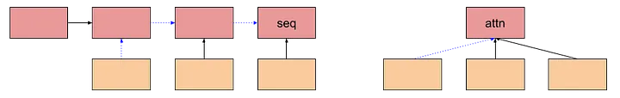
Attention
The dog is a Labrador.
Weight / pay attention to different parts of a sequence according to how important they are
Attention mechanism = trainable weights
Allows you to look at the entire sequence at once!
  Does not care about order
Notes:
https://ai.stackexchange.com/questions/21389/what-is-the-intuition-behind-the-attention-mechanism
https://avinashselvam.medium.com/intuition-for-concepts-in-transformers-1f42b0200a77

Slide 9
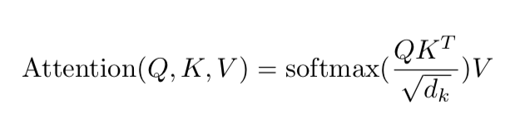
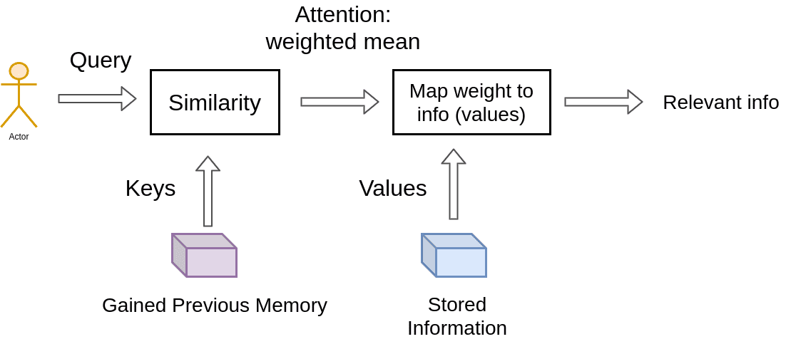
Scaled Dot-Product Attention
Q (Query), K (Key), V (Value) are vectors; come from info retrieval systems
  Q = info you’re seeking a representation for
  K = info contained in the values
  V = info itself
K, V represent memory
Notes:
Good explanation of dot-product attention: https://www.youtube.com/watch?v=rBCqOTEfxvg&t=946s
https://stats.stackexchange.com/questions/421935/what-exactly-are-keys-queries-and-values-in-attention-mechanisms?rq=1

Slide 10
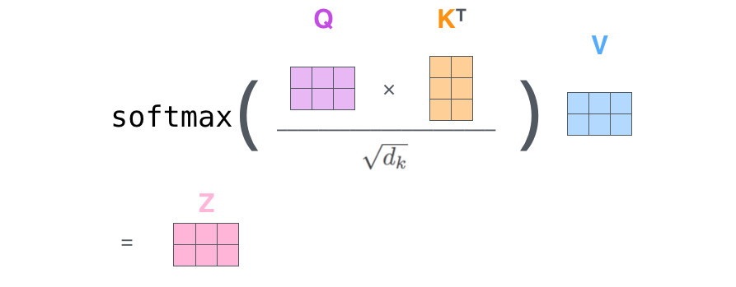
Scaled Dot-Product Attention
QK^{T}: dot-product similarity
Softmax → generate probability distribution/mask over keys
Scaled: Divide by by √d_{k} → variance = 1 → gentler softmax
MatMul w/ V → summing over values multiplied by mask → get the most relevant info
Notes:
https://d2l.ai/chapter_attention-mechanisms-and-transformers/queries-keys-values.html
d_k = dimension of q/k

Slide 11
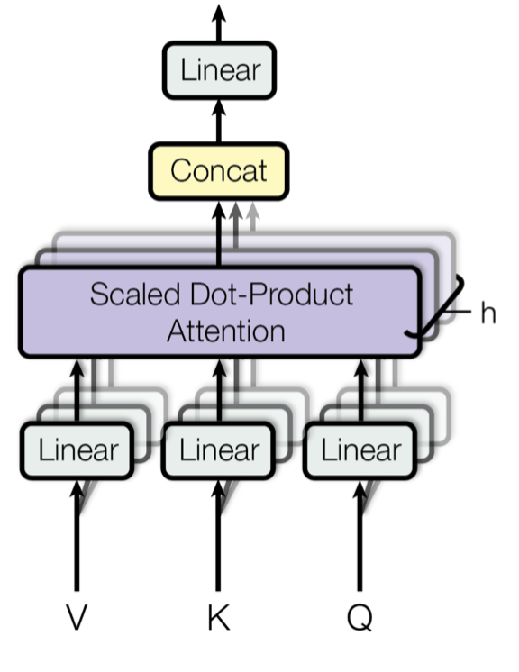

Multi-Head Attention
Idea: Attend to different parts of input seq differently each time
Extract info from different learned representation spaces by projecting Q/K/V by weight matrices
Heads are independent → train in parallel
Notes:
https://medium.com/lsc-psd/introduction-of-self-attention-layer-in-transformer-fc7bff63f3bc
https://towardsdatascience.com/attention-and-its-different-forms-7fc3674d14dc
https://machinelearningmastery.com/the-transformer-attention-mechanism/

Slide 12
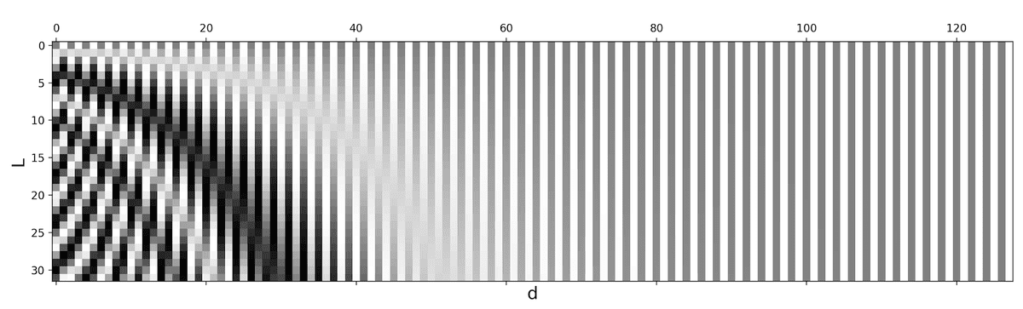
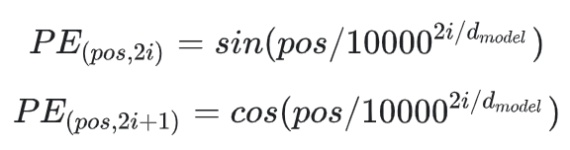
Positional Encoding
Idea: tokenization → set (no order) → add encoding which give more context about a token’s position
Uses sine/cosine functions at different wavelengths which are dependent on a token’s position in a sentence
Allows you to pay more attention to tokens which aren’t close enough (unlike recurrent models)

Slide 13
Feed-Forward Net
Purpose: Process output from attention layer in a way which better fits it for the input of the next attention layer
Idea: Add more parameters / nonlinearity
Notes:
https://stats.stackexchange.com/questions/485910/what-is-the-role-of-feed-forward-layer-in-transformer-neural-network-architectur

Slide 14
Sublayer Connections
Layer normalization: normalize input distribution across the features
Dropout: prevents overfitting
Residual connections: add some of a particular block’s input to the output, reduces vanishing gradient
Notes:
https://stats.stackexchange.com/questions/565196/why-are-residual-connections-needed-in-transformer-architectures

Slide 16
Encoder
Apply attention + FFN for each head, repeat

Slide 17
Decoder
Components are very similar
Two multi-head attention blocks
  First works with previous decoder outputs
    Autoregressive
    Masked (will explain next)
  Second works with encoder output

Slide 18
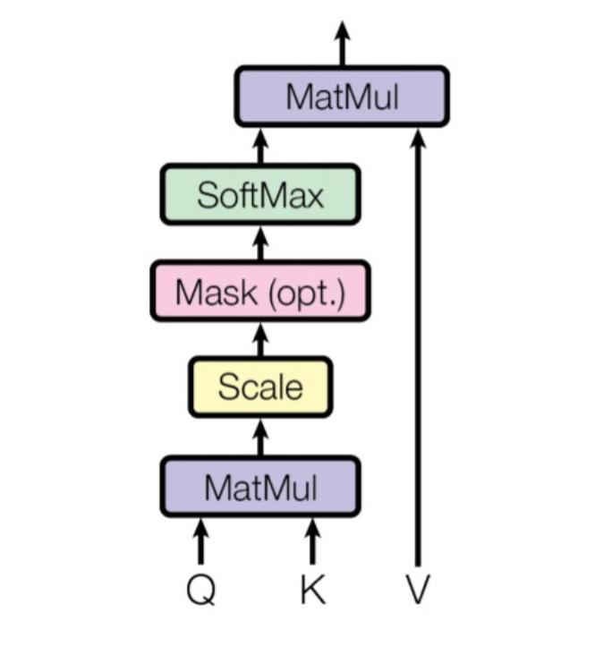
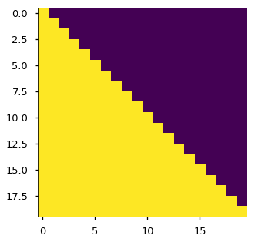
Masking
Purpose: ensures that the model is autoregressive
Ensures that multi-head attention is masked so it can’t cheat by seeing future words from the decoder input
Notes:
https://medium.com/analytics-vidhya/masking-in-transformers-self-attention-mechanism-bad3c9ec235c

Slide 19
Where do Q, K, V come from?
Encoder attention block
  Q, K, V come from input sequence (self-attention)
Decoder attention block
  Q, K, V come from output sequence (self-attention)
Decoder-encoder attention block
  Q = output sequence
  K, V = input sequence
Notes:
https://medium.com/analytics-vidhya/understanding-q-k-v-in-transformer-self-attention-9a5eddaa5960

Slide 21
Code
Check out this tutorial for a from-scratch implementation from: https://colab.research.google.com/github/dlmacedo/starter-academic/blob/master/content/courses/deeplearning/notebooks/tensorflow/transformer.ipynb
There’s also a demo on HuggingFace’s transformers library we created: https://colab.research.google.com/drive/1Jw5jvZbxRsunOVRqt6eb4aiPOmeNwSnv?usp=sharing

Slide 22
Additional Resources
How transformers work… (linked)
The Annotated Transformer [with code] (linked)
The Transformer Model in Equations [math] (linked)
Lilian Weng’s blogposts
  Attention (linked)
  The Transformer Family v2 (linked)
Andrej Karpathy: Building GPT from Scratch [Video] (linked)
“Attention is All You Need” (2017): linked
Notes:
https://github.com/christianversloot/machine-learning-articles/blob/main/differences-between-autoregressive-autoencoding-and-sequence-to-sequence-models-in-machine-learning.md

Slide 23


